Slide 1
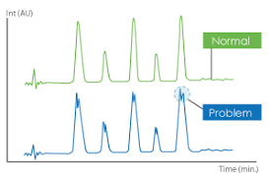
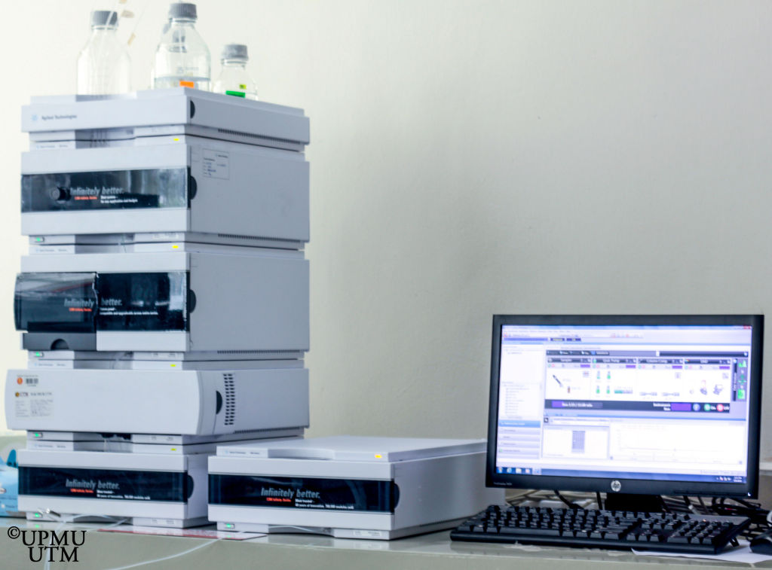
HPLC Practical 1
J. Pillay

Slide 2
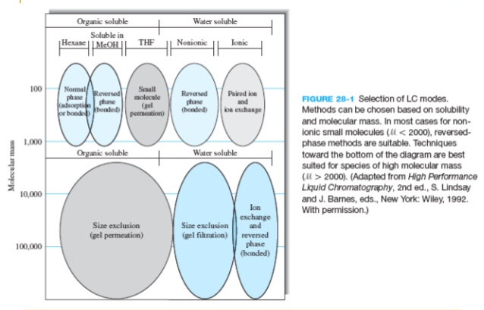
LC Modes of Separation

Slide 3

Reverse phase vs. Normal phase

Slide 4
Changing the mobile phase composition alters the separation

Slide 5
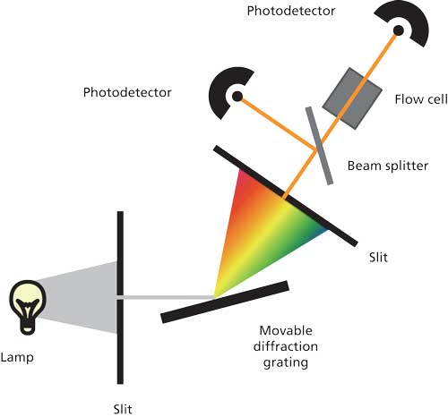
DAD Detector
Light from a deuterium lamp is directed through a slit onto a diffraction grating, which spreads the white light into its various wavelengths.
The grating is rotated to direct the desired portion of the spectrum through another slit. The slit width, or spectral bandwidth, typically is approximately 5 nm.
The light is then directed through the flow cell onto a photodiode.
As sample passes through the flow cell, the amount of light transmitted to the photodetector is reduced, and this difference in transmittance is converted into the detector output in absorbance units (AU).
A beam splitter is included, directing part of the light to another photodiode. This allows the electronics to make corrections for fluctuations in the lamp intensity and thus improve the optical performance of the instrument.

Slide 6

DAD Detector

Slide 7

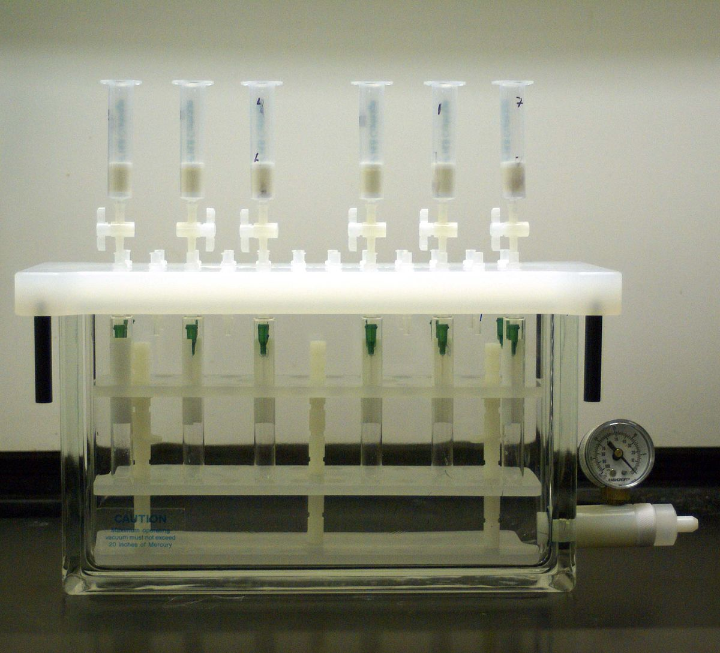

Solid Phase Extraction
Please include a brief description of the different extractions method that were discussed i.e. Liquid-liquid, solid phase extraction, dilute and shoot

Slide 8
Analgesic Separation Prac
Solvent solution: Methanol: acetic acid (95:5; v/v) → Std & sample diluent
Mobile phase: Water: methanol: glacial acetic acid (69:28:3). Prepare 500mL
Internal standard solution (ISTD): Benzoic acid in methanol (±1 mg/mL)
Sample Prep:
Please determine the concentrations of all analytes in all the analysed samples and controls.
Urine
Filter
5x Dlution + IS
(200uL sample + 800uL H2O)
Plasma
Filter
5x dilution +IS
(200uL sample + 800uL H2O)
Beverage
Filter
25x Dilution +IS
40 uL sample + 960uL H₂O

Slide 9
Calibration
Salicylic acid
4mg/mL
Working Solution
Aspirin 0.6mg/mL
SA 0.6mg/mL
Para 0.5 mg/mL
Caffeine 0.1 mg/mL
Paracetamol
1mg/ml
Caffeine
1mg/mL
Aspirin
4mg/mL
Calibration Curve:
Std 1 → Std 7
WS + Solvent mix + ISTD

Slide 10
Control Ranges
Roche Controls | Acetylsalicylate (µg/mL) | Acetaminophen (µg/mL)
TDM 1 | 32.4 – 48.6 (40.5) | 10.2 – 19.2 (14.7)
TDM 2 | 130 – 196 (163) | 28.2 – 42.0 (35.1)
TDM 3 | 359 – 539 (449) | 88 – 130 (109)
Acet Cal |  | 300
Sample 2-Compral: 453.6mg Aspirin + 324mg paracetamol + 64mg caffeine dissolved in 10mL H₂O
Sample 4- Disprin: 300mg Aspirin dissolved in 10mL H2O
In your report, discuss possible causes for any discrepancies in the concentrations you obtained in your analysis

